Slide 1
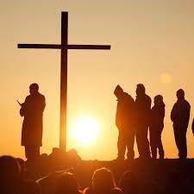
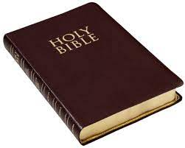
Year 3:
Summer 2
Knowledge Organiser: Religious Education
Big Question:
What does it mean to be a Christian in Britain today?
By the end of this unit you will:
Describe how Christians show their beliefs in thir home and at church
Describe how different Christians use music in worship
Describe what happens during holy communion and why it is celebrated by most Christians
Describe ways in which Christians help their community
Know why people stand up against injustice
Key Vocabulary:
Community | A group of people living in the same place or having a particular characteristic in common
communion | A Christian ceremony based on Jesus’s last meal
injustice | Lack of fairness
discrimination | The treatment of a person or a group of people differently
Strand:Living

