Slide 1

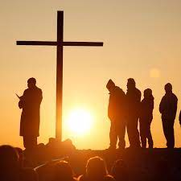
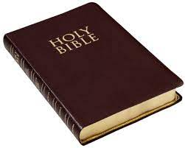
Year 3:
Summer 1
Knowledge Organiser: Religious Education
Big Question:
Why do people pray?
By the end of this unit you will:
Understand the idea of prayer
Know about prayer in Islam
Know about prayer in Christianity
Know about prayer in Hinduism
Identify the similarities and differences in the words of the 3 prayers
Key Vocabulary:
Pillars of Islam | 5 duties upon the Muslim
Worship | To honour or show reverence to a divine being
Strand:Believing

